Slide 1
Common OLS Problems and Solutions

Slide 2
Inference vs Prediction Tasks

Slide 3
Inference Tasks
Establishing quantified relationships between variables
Relevant for theoretical aims
Main focus: the consistency and unbiasedness of coefficient estimates and the prediction of Y
Ex:
“What is the relationship between X and Y?”
“Is X a relevant factor for determining Y?”

Slide 4
Prediction Tasks
Creating statistical predictions based on data
Only evaluated in terms of accuracy measurements
Main focus: for predicting values of Y out of model
Ex:
“Can I predict how many Y’s will be sold with X’s?”
“Can I predict that Y occurs if I have X?”

Slide 5
1.
Linear Regression Summary
The tried and true

Slide 6
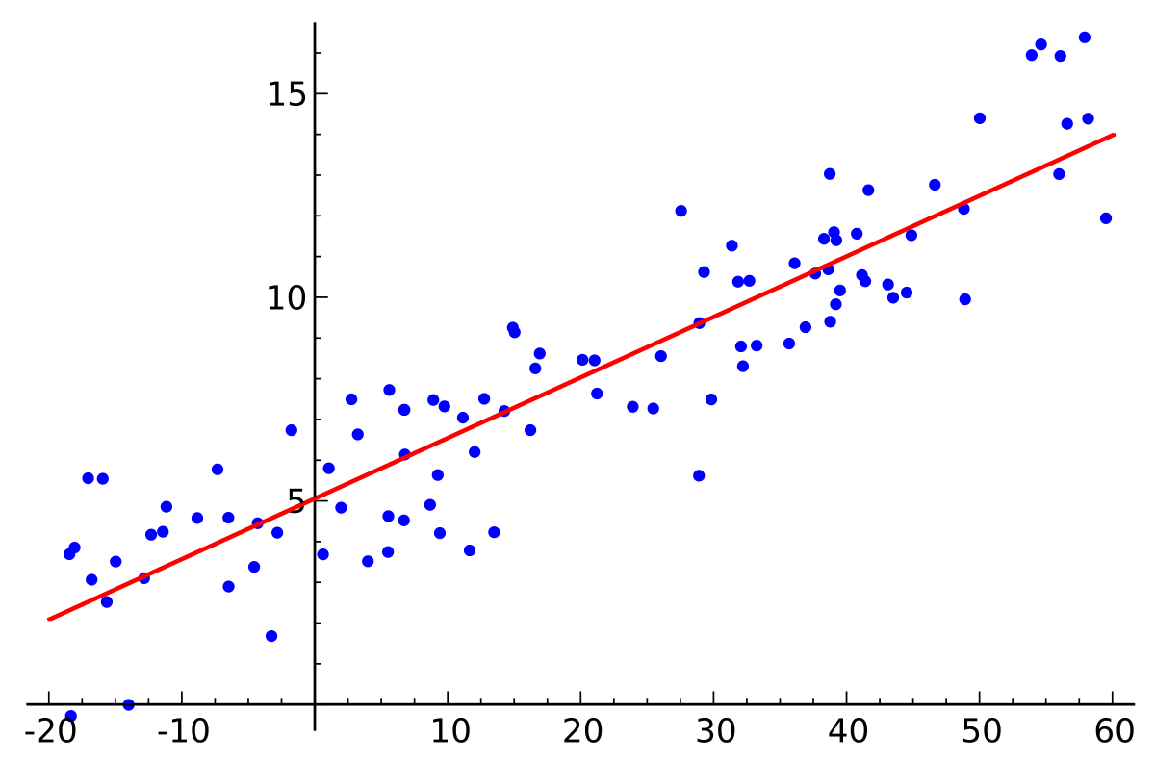
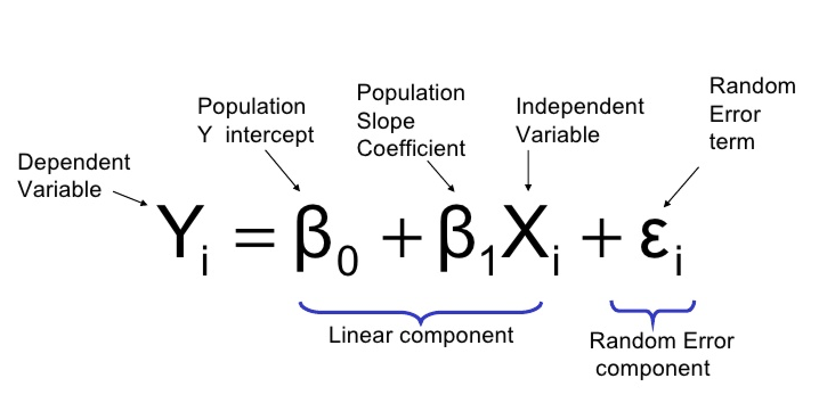

Linear Regression (OLS)

Slide 7
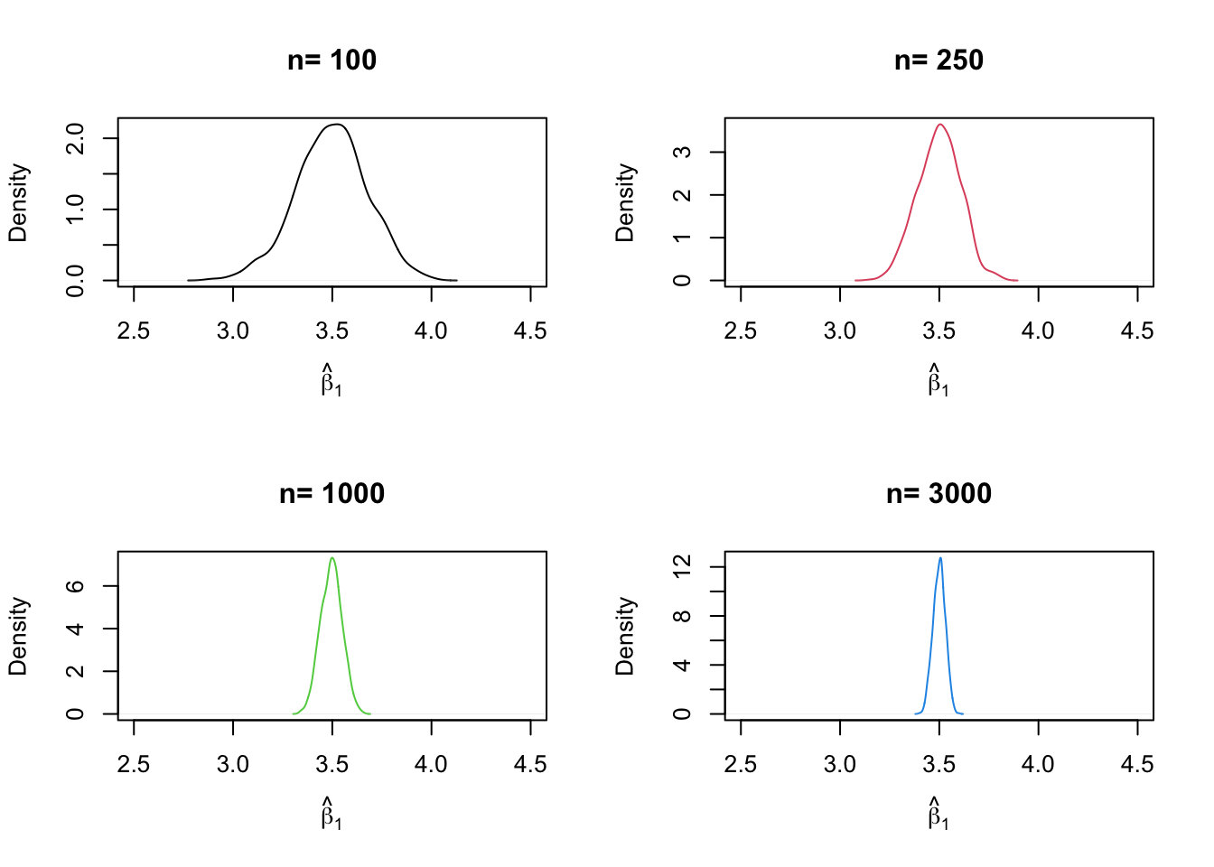

Slide 8
OLS Assumptions for (Causal) Inference
Conditional Distribution of 𝞮 is given Xi has a mean zero
Regressors are not linearly related to the error term
Sample observations are independently and identically distributed
Large Outliers are unlikely
No perfect multicollinearity

Slide 9
OLS Assumptions for Prediction
(Xtest, Ytest) are randomly drawn from the same population distribution as (Xi, Yi)
The distribution of training data is the same as the distribution of the data you want to predict on
Sample observations are independently and identically distributed
Large Outliers are unlikely
No perfect multicollinearity

Slide 10
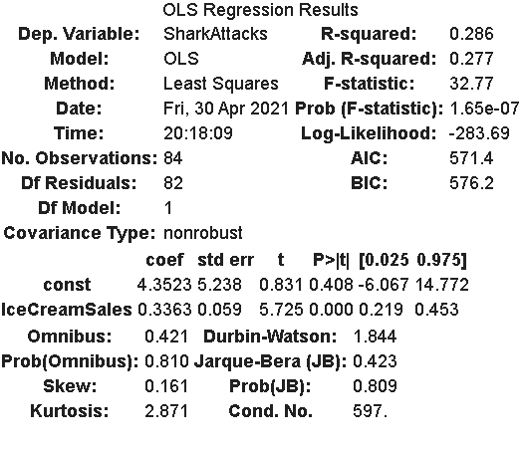
Regression Analysis
Inference
Parameter focused
P-values
Standard Errors
Confidence Intervals
Prediction
Model focused
R^2 (and adjusted R^2)
P-values
Model fit

Slide 11
OLS in a Nutshell
High interpretability
Low flexibility and robustness
Need to be conscientious of assumption violations!
Extremely powerful and relatively simple

Slide 12
Inference Problems
Find more maps at slidescarnival.com/extra-free-resources-icons-and-maps

Slide 13

2.
Omitted Variable Bias

Slide 14
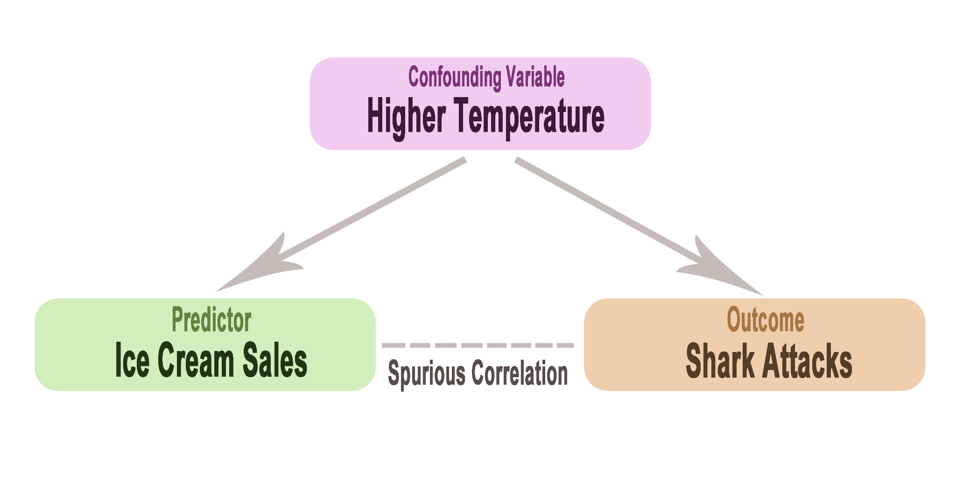

Slide 15
Omitted Variable Bias
Omitted variable bias will occur when both of the following two conditions are met:
An omitted variable (outside the model) is correlated with a regressor (Xi in the regression equation)
The omitted variable is a determinant of the dependent variable (Yi in the regression equation
When the two conditions are met, OLS assumption 1 does not hold!

Slide 16
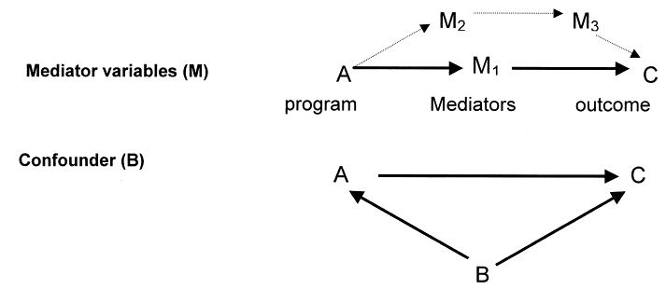

Slide 17
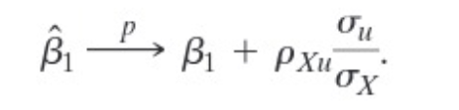

OVB in OLS regression
Biased and inconsistent coefficients!
Bias can be positive or negative
Bias size varies depending on correlation with error term
OVB is unaffected by sample sizes

Slide 18
Addressing and Preventing OVB
Subset data
Subsetting the data such that the omitted variable is held constant in your model
Multivariate regression
Internalize the omitted variable so that it can be controlled for in the model
Randomized Control Trial (RCT)
RCT’s avoid OVB because when randomly assigned effect A, effect A only occurred by experimental design and therefore there could not have been a confounding variable causing the effect

Slide 19

Multivariate Regression
OLS can be extended to multiple dimensions!
1 predictors = models line
2 predictors = models plane
k predictors = models k-1 dimensional hyperplane
Avoids OVB on parameter estimation by allowing the model to adjust coefficient values to the right predictors

Slide 20

Multivariate Regression
Univariate case
Not controlling for confounding variable
Multivariate case
Controlling for confounding variable

Slide 21

3.
Perfect Multicollinearity

Slide 22
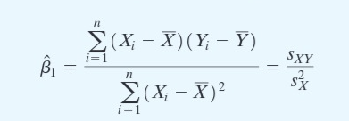
Perfect Multicollinearity
OLS Assumption 4
Occurs when predictor A is perfectly correlated to predictor B
Equation is not possible to calculate when two predictors have the same values

Slide 23
Addressing Perfect Multicollinearity
OLS is literally impossible when there is perfect multicollinearity!
Don’t include perfectly correlated variables
Regression packages often just omit one for you

Slide 24
4.
Heteroskedasticity

Slide 25
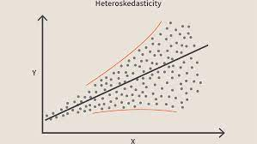
Heteroskedasticity
Violation of first OLS causal assumption
Can lead to smaller p-values if not addressed
Creates inconsistency in coefficient estimates
Larger samples help with this!
*note: heteroskedasticity does not bias the estimate though

Slide 26
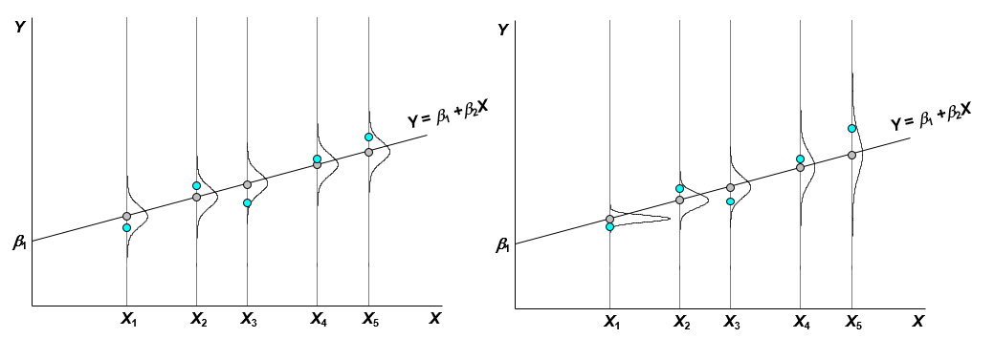
How to Address Heteroskedasticity
Robust regression
Weighted Least Squares Regression

Slide 27
Prediction Problems

Slide 28

5.
Including Noise Variables

Slide 29
Why Not Include All Variables?
“If you include all possible variables in model, that model is the least likely to have OVB!”
Non-decreasing property of R^2
Adding another predictor will never decrease training R^2 value
So why not?

Slide 30
There Can Be Too Many!
Too many predictors can overfit your model
This will be expanded on later in the course when we talk more about cross validation
Training R^2 != Testing R^2
Only include the variables that are of interest, help control for OVB, and have theoretical motivations for being included
Without theoretical motivations, use subset selection methods: stepwise selection, best subset selection, etc.

Slide 31
6.
Nonlinearity of Parameters

Slide 32
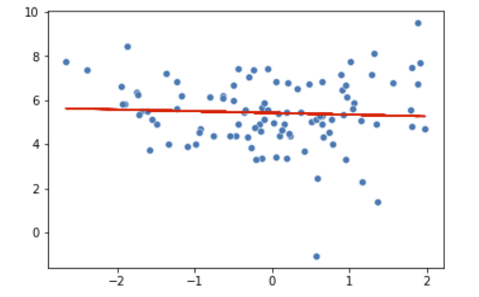
What if the data is not linearly related?
Can a linear model provide unbiased and consistent estimates of Y when the relationship between X and Y is nonlinear?

Slide 33
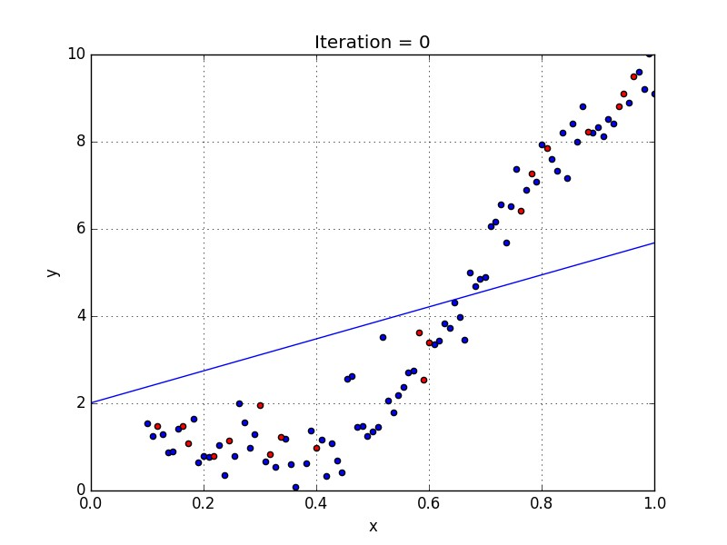
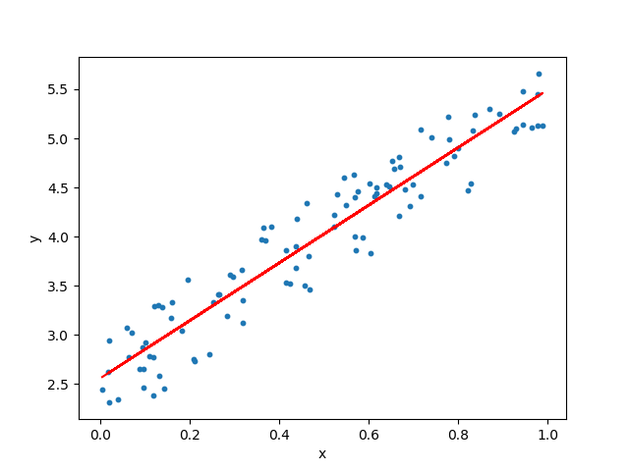

Slide 34
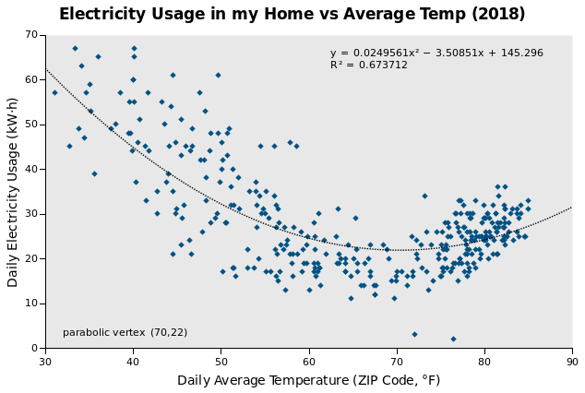
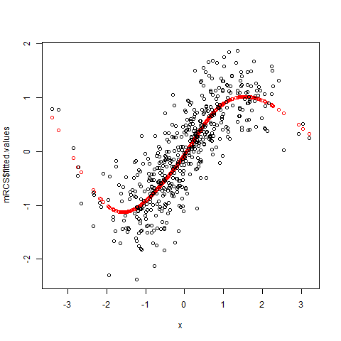
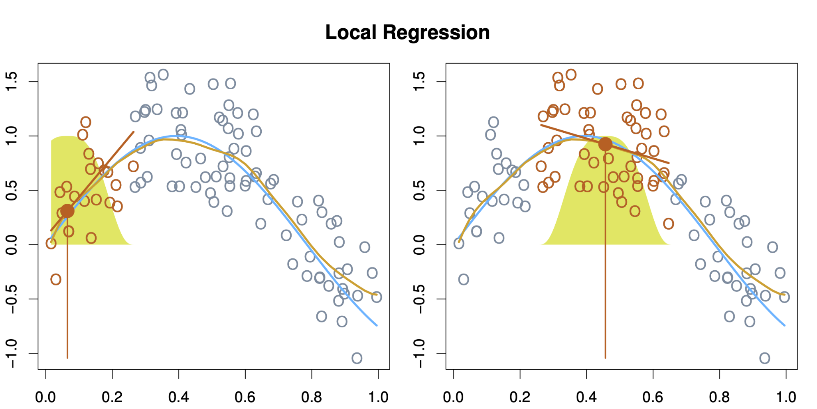
Nonlinear modeling
Many nonlinear models out there!
Local linear regression
Polynomial regression
Quadratic Regression
Cubic Regression
Etc.

Slide 35
THE END

